Slide 1


Gas leakage detection and alerting system
MINOR PROJECT – I
FIRST REVIEW
BATCH - 18
BY
MAHENDRAVARMAN R S [927621BEC111]
MALLESH S [927621BEC112]
KUMAR N [927621BEC098]
SANTHOSH P [22LEC010]
Manikandan s g [22lec021]
GUIDE
Dr.K.SIVANANDAM

Slide 2
LIST OF CONTENT
Abstract
Introduction
Existing Method
Proposed Method
Components required
Future work
References
M.Kumarasamy College Of Engineering

Slide 3
Abstract
Gas leakage detection and alerting system uses a gas sensor to detect the gas leakage.
The existing idea of using Arduino microcontroller is costly to implement.
This system is based on NodeMCU ESP8266 which is economically beneficient than the old model.
M.Kumarasamy College Of Engineering

Slide 4
INTRODUCTION
Nowadays, the usage of Liquefied Petroleum Gas (LPG) in India is widely used in many fields such as in homes, restaurants, industries (small scale to big scale) and in automobiles as fuels.
Leakages may lead to explosion which can lead to many deaths. As the usage of LPG increases in domestic, the accidents occur by these LPG explosion also increases due to lack of continuous inspections and monitoring.
This system uses a mobile app to receive an alerting notification, and reliable in communications between the user and the system.
M.Kumarasamy College Of Engineering

Slide 5
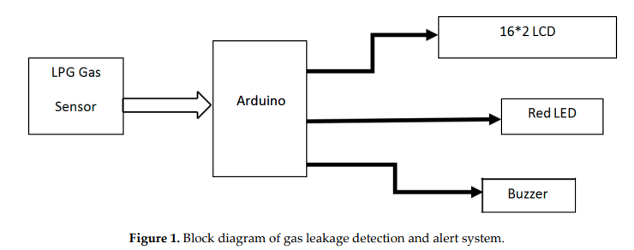
EXISTING METHOD
This system is based on the Arduino UNO R3 and MQ-6 gas sensor. When the sensor detects gas in the atmosphere, it will give digital output 1 and if gas in not detected the sensor will give digital output 0.
Arduino will receive the sensor output as digital input. If the sensor output is high, then the buzzer will start tuning along with the LCD that will show that “Gas detected: Yes”.
If the sensor output is low then buzzer will not be tuning, and the LCD will show that “Gas detected: No”.
The following Shows the block diagram of existing
model.
M.Kumarasamy College Of Engineering

Slide 6
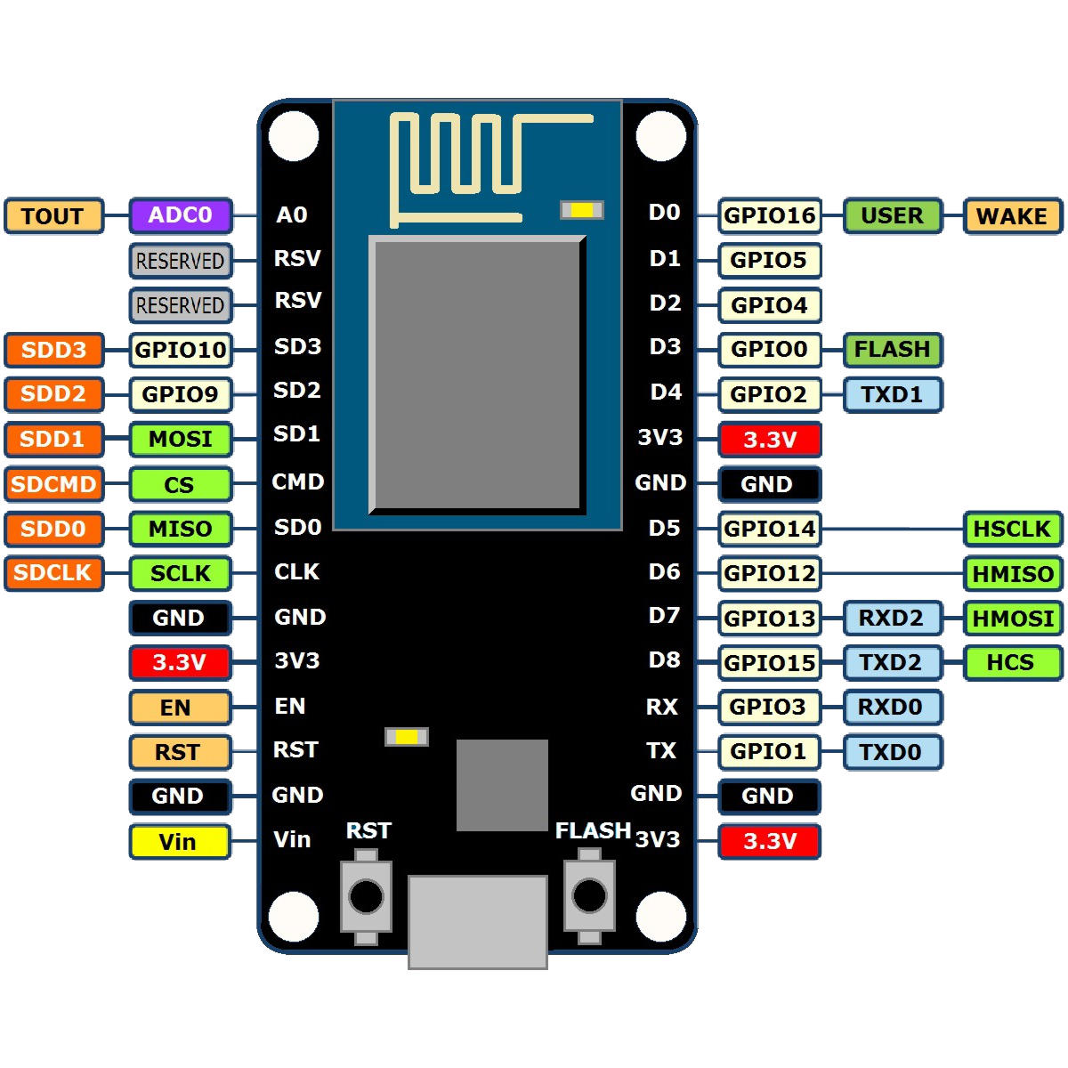
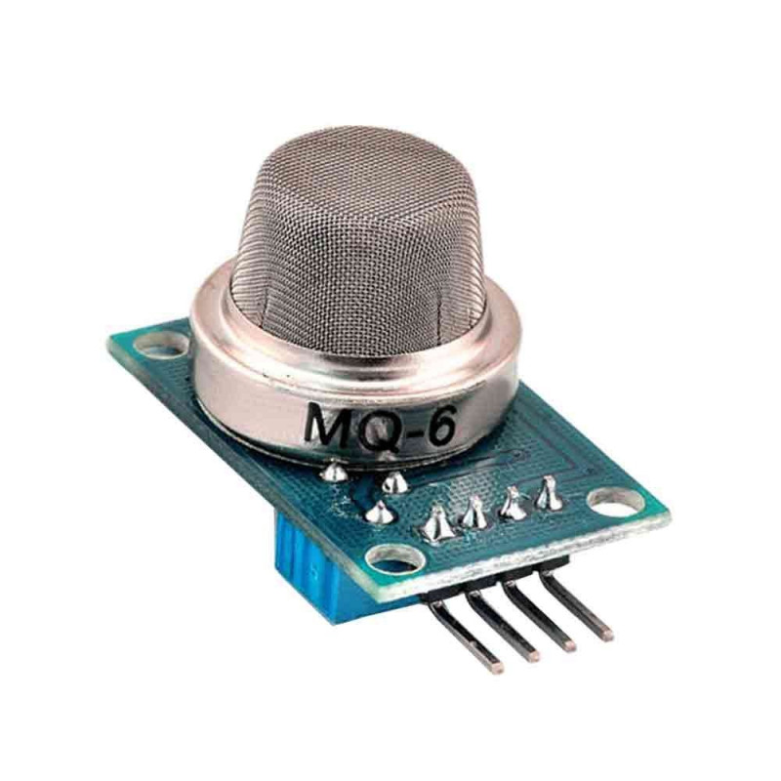
PROPOSED METHOD
The design of the proposed method is based on NODEMCU ESP8266, MQ6 Gas sensor, an LED.
We can use NODEMCU ESP8266 to send notification to mobile.
M.Kumarasamy College Of Engineering

Slide 7
COMPONENTS REQUIRED
NODEMCU ESP8266
MQ6 GAS SENSOR
BREADBOARD
LED
JUMPER WIRES
POWER SUPPLY
M.Kumarasamy College Of Engineering

Slide 8
FUTURE WORK
Understand the concept and functions of NODEMCU ESP8266, MQ6 GAS SENSOR.
Use blynk app to receive email and notification.
M.Kumarasamy College Of Engineering

Slide 9
REFERENCES
sitan, T. S. a/p, & Ab Ghafar, A. S. (2018). Liquefied Petroleum Gas (LPG) Leakage Detection and Monitoring System. Journal of science and Technology, 10(3). Retrieved from https://publisher.uthm.edu.my/ojs/index.php/JST/article/view/2587
M. Santiputri and M. Tio, "IoT-based Gas Leak Detection Device," 2018 International Conference on Applied Engineering (ICAE), 2018, pp. 1-4, doi: 10.1109/INCAE.2018.8579396.
Jahan, Shawkat, et al. "Development of smart cooking stove: harvesting energy from the heat, gas leakage detection and IoT based notification system." 2019 International Conference on Robotics, Electrical and Signal Processing Techniques (ICREST). IEEE, 2019.
M.Kumarasamy College Of Engineering

Slide 10
THANK YOU
M.Kumarasamy College Of Engineering

